Slide 1
Generating Minimal Unsatisfiable SAT Instances from Strong Digraphs
G. Kusper, T. Balla, Cs. Biró, T. Tajti, Z.Gy. Yang, I. Baják
Eszterházy Károly University
Eger, Hungary

Slide 2
Outline
Motivation
In media res
SAT, CNF, Clause Set, Clause, Literal
BB, WW
Black-and-White SAT Problem
Communication Graph
Strong Model, Weak Model
Minimal Unsatisfiable Clause Sets (MUs)
Test results

Slide 3
Motivation
Since 2012 we have a research group, called:
Formal Methods and Verifications Research Group
We have a SAT solver: CSFLOC
We study links between Graph Theory and SAT Problem
We have several models
One of our model is suitable to generate Mus
MUs are very difficult problems for SAT solvers

Slide 4
in medias res
Test results

Slide 5
Weak models, Testset 1
Name | Size in Bytes | Number of nodes | Number of edges | Density
10_32_0.36_WM.cnf | 13.963 | 10 | 32 | 0.36
11_36_0.33_WM.cnf | 30.444 | 11 | 36 | 0.33
12_40_0.30_WM.cnf | 58.861 | 12 | 40 | 0.30
13_44_0.28_WM.cnf | 148.890 | 13 | 44 | 0.28
14_48_0.26_WM.cnf | 219.728 | 14 | 48 | 0.26
15_52_0.25_WM.cnf | 553.685 | 15 | 52 | 0.25
16_56_0.23_WM.cnf | 1.041.500 | 16 | 56 | 0.23
17_60_0.22_WM.cnf | 2.120.068 | 17 | 60 | 0.22
18_64_0.21_WM.cnf | 5.263.719 | 18 | 64 | 0.21
19_68_0.20_WM.cnf | 7.889.500 | 19 | 68 | 0.20
20_72_0.19_WM.cnf | 16.420.037 | 20 | 72 | 0.19

Slide 6
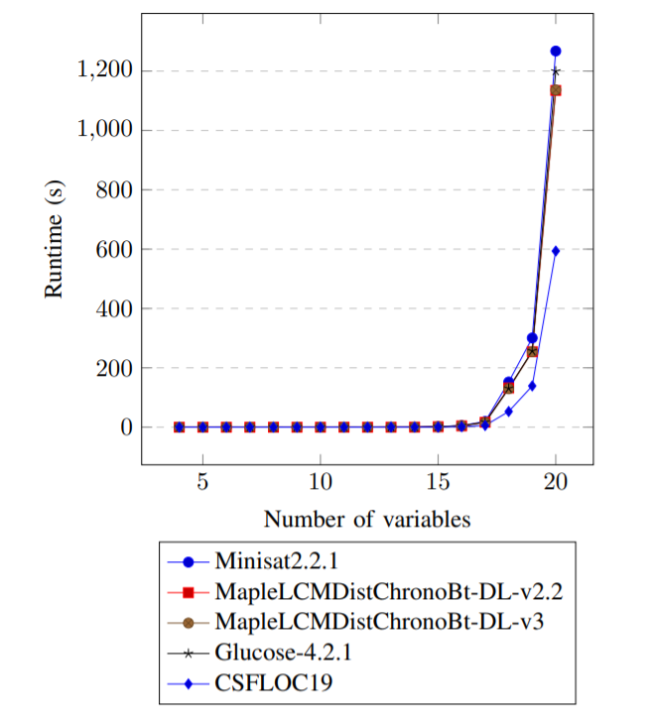

Slide 7
Weak models, Testset 2
Name | Size in Bytes | Number of nodes | Number of edges | Density
10_90_1.00_WM.cnf | 29.721 | 10 | 90 | 1.0
11_110_1.00_WM.cnf | 66.586 | 11 | 110 | 1.0
12_132_1.00_WM.cnf | 147.483 | 12 | 132 | 1.0
13_156_1.00_WM.cnf | 323.612 | 13 | 156 | 1.0
14_182_1.00_WM.cnf | 704.542 | 14 | 182 | 1.0
15_210_1.00_WM.cnf | 1.523.743 | 15 | 210 | 1.0
16_240_1.00_WM.cnf | 3.276.832 | 16 | 240 | 1.0
17_272_1.00_WM.cnf | 7.012.386 | 17 | 272 | 1.0
18_306_1.00_WM.cnf | 14.942.243 | 18 | 306 | 1.0
19_342_1.00_WM.cnf | 31.719.460 | 19 | 342 | 1.0
20_380_1.00_WM.cnf | 67.108.902 | 20 | 380 | 1.0

Slide 8
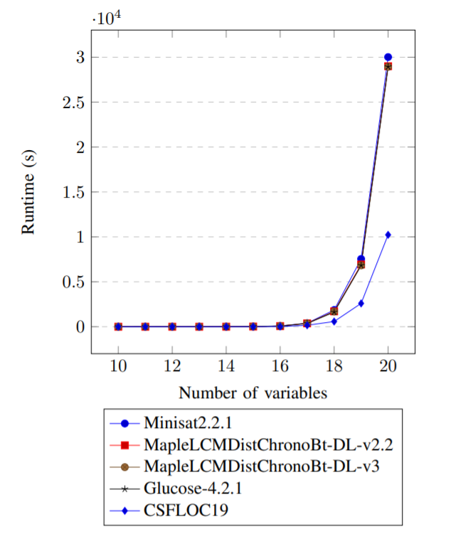

Slide 9
Boolean Satisfiability (SAT)
Identify truth assignment that satisfies boolean formula or prove it does not exist
Well-known NP-complete problem

Slide 10
Conjunctive Normal Form (CNF)
S = ( a ∨ c ) ∧ ( b ∨ c ) ∧ (¬a ∨ ¬b ∨ ¬c )
Positive Literal
Negative Literal
Clause

Slide 11
Representations
CNF: (A or not B or C) and (not A or not B) and (B)
Set based: {{A, not B, C}, {not A, not B}, {B}}
DIMACS:
1 -2 3 0
-1 -2 0
2 0
A solution: B = true, A = false, C = true
Actually, there is no other solution!

Slide 12
Subsumed full length clauses
S = ( a ) ∧ ( b ∨ c ) ∧ (¬a ∨ ¬b ∨ ¬c )
Subsumed full length clauses:
(a ∨ ¬b ∨ ¬c )
(a ∨ ¬b ∨ c )
(a ∨ b ∨ ¬c )
(a ∨ b ∨ c )
Subsumed full length clauses:
(¬a ∨ b ∨ c )
(a ∨ b ∨ c )
A full length clause

Slide 13
Minimal Unsatisfiable Clause Sets (MUs)
The full-length clause C is independent in S iff C is not subsumed by S \ {C}
The clause C is independent in S iff there exists a full-length clause D such that C subsumes D and D is independent in S \ {C}.
The clause set S is a MU iff S is UNSAT and all clauses C in S is independent in S.
Some MUs:
{ { } }
{ { A }, { notA } }
{ { A }, { B }, { notA, notB } }
{ { A, B }, { A, not B }, { notA, B }, { notA, notB } }
{ { A, notB }, { notB, C }, { notC, A}, { A, B, C }, { notA, notB, notC } }

Slide 14
The Black-and-White SAT problem
The white assignment (WW) assigns to each variable true.
Example: A = true, B = true, C = true
The black assignment (BB) assigns to each variable false.
Example: A = false, B = false, C = false
A SAT problem is black-and-white iff it has only two solutions, the white assignment, and the black one.
Example:
-1 2 0
-2 3 0
-3 1 0

Slide 15
Digraph
a
b
c
D = (V, E) is a digraph, where
V is the set of vertices, and
E is the set of edges,
edges are ordered pairs of vertices.
Example: V = {a, b, c}, E = {(a,b), (b,c), (c,a)}.
A digraph is strongly connected iff
there is a path from each vertex to each other vertex.

Slide 16
Communication graph
The directed graph (V, E) is a communication graph iff
for all a in V have that (a, a) is not in E, and
if x is an element of V then not x must not be an element of V.
Example:
a
b
c

Slide 17
A relationship between directed graphs and black-and-white SAT problems.
Let D be a communication graph.
Let SM be the strong model of D.
Let WM be the weak model of D.
Let BBog be the Balatonboglár model of D.
Then SM, WM, and BBog are
Black-and-White SAT problems iff D is strongly connected.

Slide 18
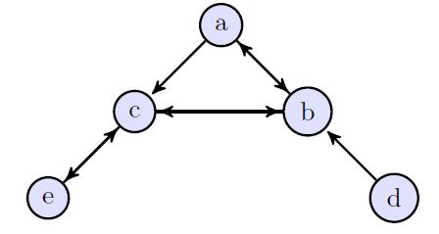
The Strong Model
Let D =(V, E) be a communication graph.
The strong model of D is denoted by SM, and defined as follows:
SM := {{ not a, b } | (a, b) in E} }.
Example:
SM ={{not a, b}, {not a, c}, {not b, a}, {not b, c},
{not c, b}, {not c, e}, {not d, b}, {not e, c}}.
Solutions:
a = b = c = d = e = true
a = b = c = e = true, d = false
a = b = c = d = e = false

Slide 19
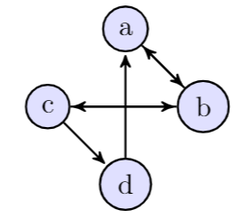
The Weak Model
Let D =(V, E) be a communication graph. The weak model of D is denoted by WM:
OutE(a) := { b | (a, b) in E }.
Cycles := { (a₁, a₂, …, a_{k}) | k=1 or for all i=1..k we have that a_{(i mod k)+1} is in OutE(a_{i}) }.
ExitPonts((a₁, a₂, …, a_{k}) ) := {b | exists i=1..k such that b is in OutE(a_{i})) and not exists j=1..k such taht b = a_{j}) }.
WM := { not C union ExitPonts(C) | C in Cycles and ExitPonts(C) is not empty }.
Example:
Cycles: (a), (b), (c), (d), (a,b), (b,c), (a,b,c,b), (a,b,c,d).
WM = { {not a, b}, {not b, a, c}, {not c, b, d}, {not d, a}, {not a, not b, c}, {not b, not c, a, d}, {not a, not b, not c, d} }.

Slide 20
Theoretical Results
Lemma 1. Let F be a Black-and-White SAT problem. Then F union { BB, WW} is unsatisfiable, where BB is the black clause, and WW is the white clause.
Lemma 2. Let D be a communication graph. Let SM be the strong model of D. Then SM implies the formula (notA or B) iff there is path from vertex A to vertex B in D.
Theorem 1. Let D be a communication graph. Let SM be the strong model of D. Then SM is a Black-and-White 2-SAT problem iff the graph D is strongly connected.
Theorem 2. Let F be a Black-and-White 2-SAT problem. Then we need linear time to show that F union {BB, WW} is unsatisfiable.
Lemma 3. Let D be a communication graph. Let WM be the weak model of D. Let SM be the strong model of D. Then WM has at least two solutions, namely the white assignment (WW) and the black assignment (BB). The same is true for SM.

Slide 21
Theoretical Results
Lemma 4. Let D be a communication graph. Let WM be the weak model of D. Assume that WM has only two solutions. Then for each cycle C in Cycles we have that ExitPoints(C) is not empty or C contains all vertices of D.
Lemma 5. If S is a Black-and-White SAT problem, then it contains no pure literal.
Lemma 6. If D is a complete communication graph, and WM is the weak model of D, then WM is a Black-and-White SAT problem.
Theorem 3. Let D be a communication graph. Let WM be the weak model of D. Then WM is a Black-and-White SAT problem iff D is strongly connected.

Slide 22
Theoretical Results
Lemma 7. Let D be a communication graph. Let SM be the strong model of D. Let WM be the weak model of D. Then SM >= WM.
Lemma 8. Let D be a communication graph. Let SM be the strong model of D. Let WM be the weak model of D. If D is strongly connected, or each vertex in D has only one child, then SM and WM are equivalent.
Lemma 9. Let D be a communication graph. Let SM be the strong model of D. Let WM be the weak model of D. Then SM > WM iff D is not strongly connected, and there is at least one vertex in it which has more than one child vertex.

Slide 23
Theoretical Results
Theorem 4 (Transitions Theorem). If for all communication graphs D we have that SM >= MM >= WM, where SM is the strong model of D, and WM is the weak model of D, and MM is an arbitrary but fixed model of D, then MM is a Black-and-White SAT problem iff D is strongly connected.
Theorem 5. Let D be a communication graph. Let BBog be a Balatonboglár model of D. Then SM >= BBog >= WM.
Theorem 6. Let D be a communication graph. Let BBog be a Balatonboglár model of D. Then BBog is a Black-and-White 3-SAT problem iff D is strongly connected.

Slide 24
Theoretical Results
Lemma 10. Let D be a communication graph. Let WM be the weak model of D. Then for all C in WM we have that C is not subsumed by WM \ {C}.
Theorem 9. Let D be a communication graph. Let WM be the weak model of D. Then for all C in WM we have that C is independent in WM \ {C}.
Corollary 1. Let D be a strongly connected communication graph. Let WM be the weak model of D. Then WM union {BB, WW} is a minimal unsatisfiable SAT instance.

Slide 25
DEMO

Slide 26
Weak models, Testset 1
Name | Size in Bytes | Number of nodes | Number of edges | Density
10_32_0.36_WM.cnf | 13.963 | 10 | 32 | 0.36
11_36_0.33_WM.cnf | 30.444 | 11 | 36 | 0.33
12_40_0.30_WM.cnf | 58.861 | 12 | 40 | 0.30
13_44_0.28_WM.cnf | 148.890 | 13 | 44 | 0.28
14_48_0.26_WM.cnf | 219.728 | 14 | 48 | 0.26
15_52_0.25_WM.cnf | 553.685 | 15 | 52 | 0.25
16_56_0.23_WM.cnf | 1.041.500 | 16 | 56 | 0.23
17_60_0.22_WM.cnf | 2.120.068 | 17 | 60 | 0.22
18_64_0.21_WM.cnf | 5.263.719 | 18 | 64 | 0.21
19_68_0.20_WM.cnf | 7.889.500 | 19 | 68 | 0.20
20_72_0.19_WM.cnf | 16.420.037 | 20 | 72 | 0.19

Slide 28
Weak models, Testset 2
Name | Size in Bytes | Number of nodes | Number of edges | Density
10_90_1.00_WM.cnf | 29.721 | 10 | 90 | 1.0
11_110_1.00_WM.cnf | 66.586 | 11 | 110 | 1.0
12_132_1.00_WM.cnf | 147.483 | 12 | 132 | 1.0
13_156_1.00_WM.cnf | 323.612 | 13 | 156 | 1.0
14_182_1.00_WM.cnf | 704.542 | 14 | 182 | 1.0
15_210_1.00_WM.cnf | 1.523.743 | 15 | 210 | 1.0
16_240_1.00_WM.cnf | 3.276.832 | 16 | 240 | 1.0
17_272_1.00_WM.cnf | 7.012.386 | 17 | 272 | 1.0
18_306_1.00_WM.cnf | 14.942.243 | 18 | 306 | 1.0
19_342_1.00_WM.cnf | 31.719.460 | 19 | 342 | 1.0
20_380_1.00_WM.cnf | 67.108.902 | 20 | 380 | 1.0

Slide 30
Thank you for your attention!
kusper.gabor@uni-eszterhazy.hu

